Slide 1
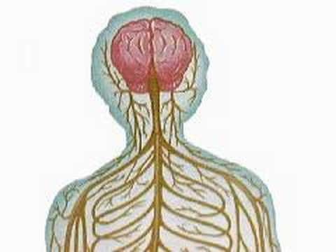
The Biology of Mind

Slide 2
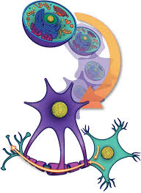
Neural Communication

Slide 3
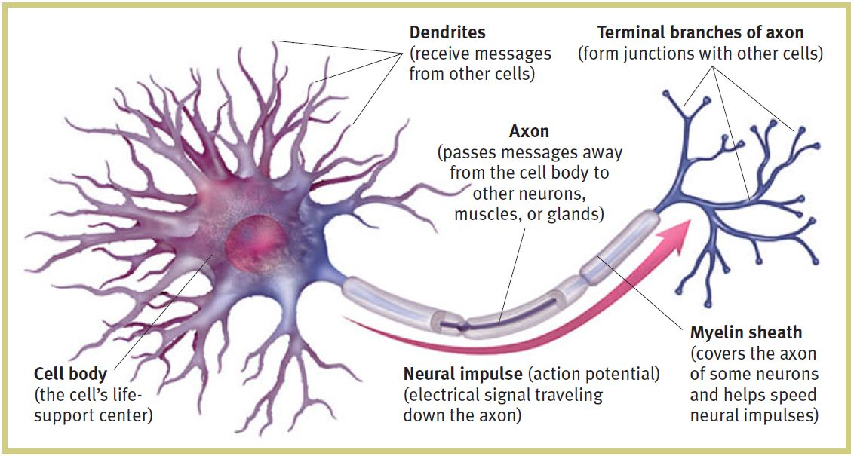
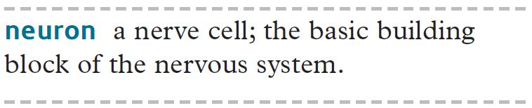

Slide 4
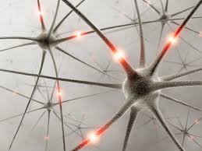
How Neurons Communicate

Slide 5
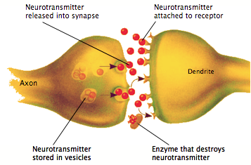
Neurotransmitter

Slide 6
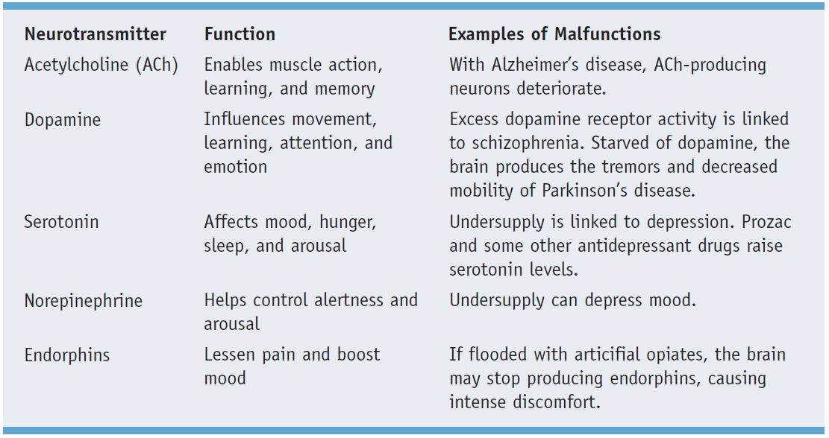
How Neurotransmitters influence us

Slide 7
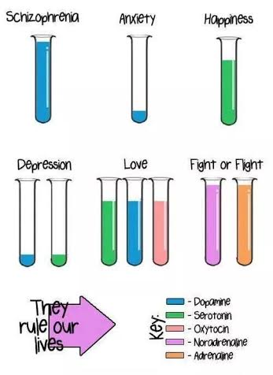

Slide 8
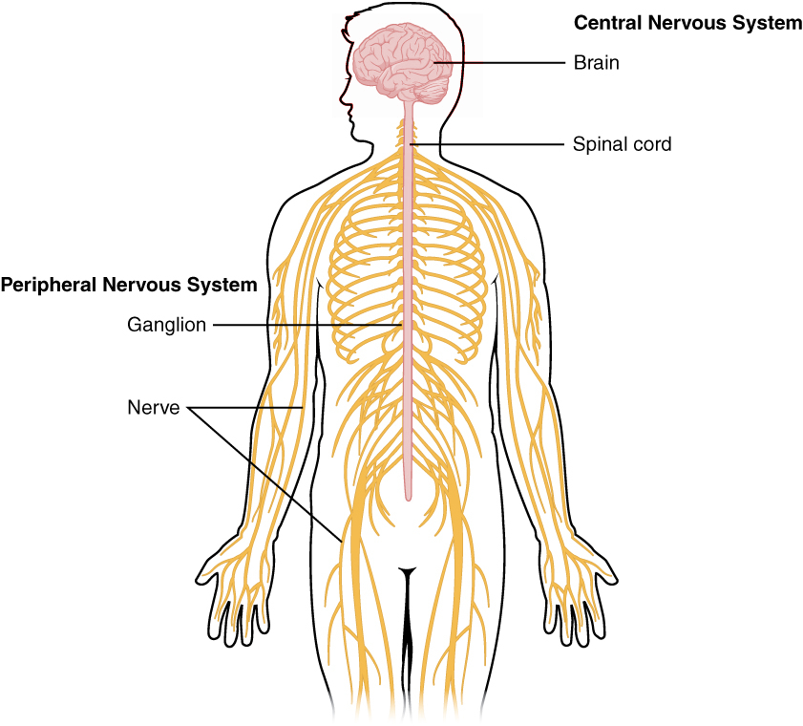
Nervous System

Slide 9
Nervous System
The system of cells, tissues, and organs that regulates the body's responses to internal and external stimuli.
The nervous system is the part of an animal's body that coordinates its voluntary and involuntary actions and transmits signals between different parts of its body (wikipedia)

Slide 10
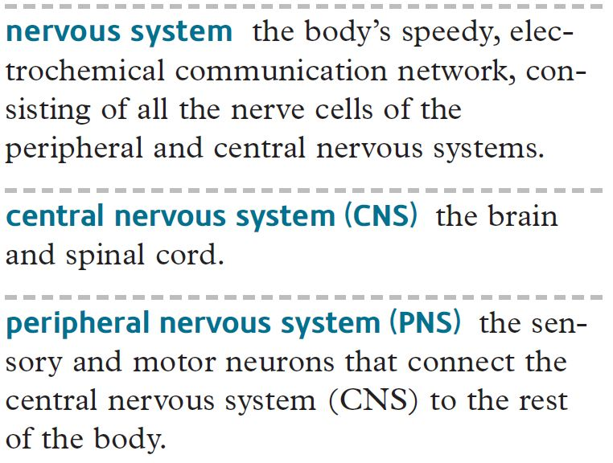

Slide 11
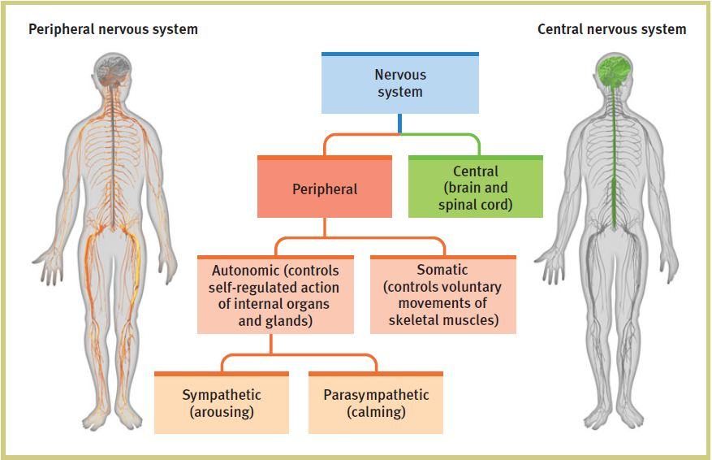

Slide 12
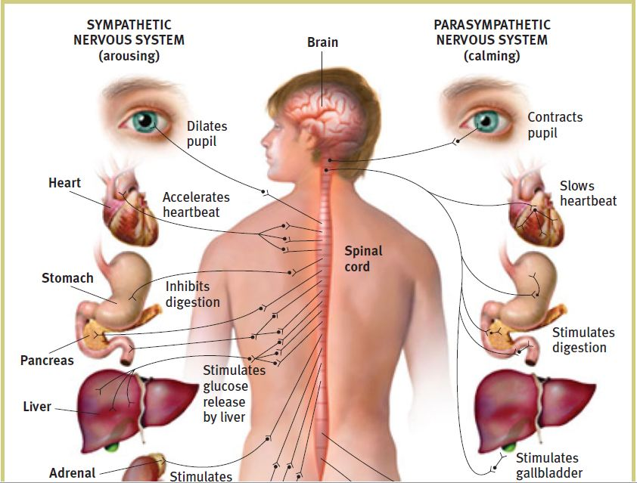

Slide 13

The Brain

Slide 14
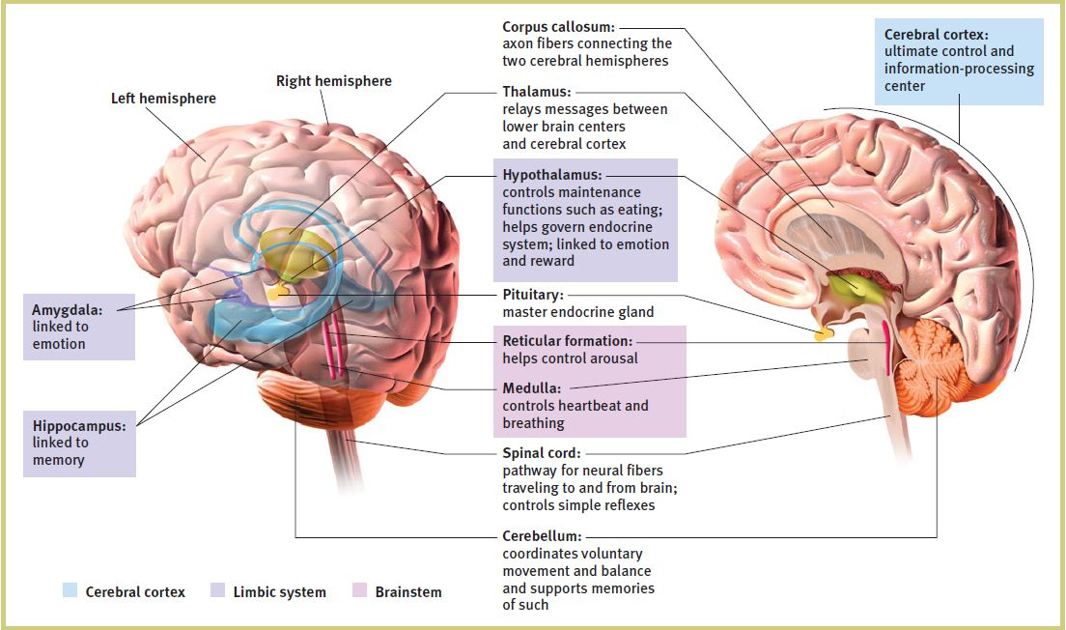
Brain Structure and Function

Slide 15
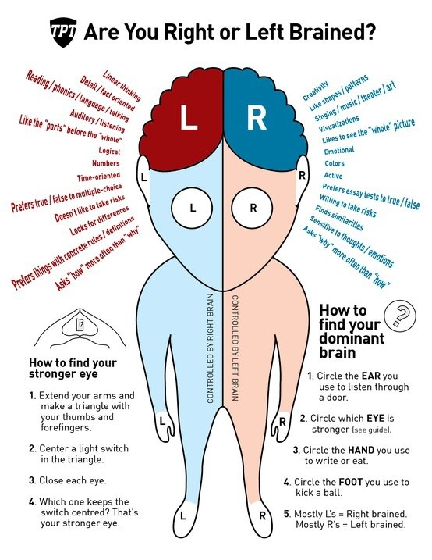

Slide 16
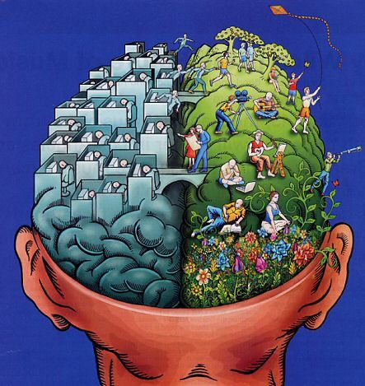

Slide 17
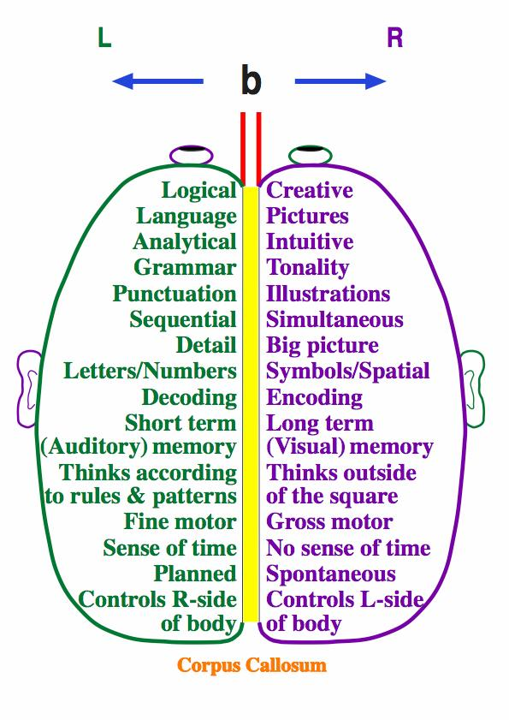

Slide 18
Activity
How to use right brain and left brain to enhance the power of your brain?

Slide 19
Neuroplasticity

Slide 20
How to enhance brain fitness?

Slide 21
Sleep sound
Do your best to get 7.5 hours of sleep and if you need to take a nap, take one! If you are one of those people that think sleep is weak and you run just fine on your 6 hours, try getting 7.5 and see how efficient you are, how much better you feel, and notice how good your mood is throughout the day!

Slide 22
Eat well
It shouldn't come as a surprise that nutrition plays a significant part in your brain health. Entrepreneurs are often rushing from one meeting to another, leaving themselves with very little or no time to eat well.
You have to focus on getting the right kind of nutrition. Antioxidants and amino acids are particularly important, and vitamin E can also be beneficial.
Nuts, blueberries, whole grains, avocados, fish oil, broccoli, tomato, seeds and water are beneficial. What's good for your body also tends to be good for your brain.

Slide 23
Exercise
If you don’t already, start exercising! You don’t have to go to a gym to exercise, there are plenty of workouts you can perform in the privacy of your own home. Beyond that, make conscious decisions to be more active. Take the stairs not the elevator, park away from the building instead of hunting for the best spot, and get up and take a walk every now and again…your body and brain will thank you!

Slide 24
Write things down
There are several ways to start doing this. My favorite is write down tomorrow’s activities/responsibilities the night before. What this does is release any worry about what you have to do the next day and you will sleep like a baby! It also allows you to wake up the next day and just follow a schedule…no-brainer! Even though it is better to write things down by hand, have an app on your phone where you can always jot things down when they come to mind. We have so many great ideas that come and go, if you don’t capture them, you may lose it forever!

Slide 25
STEP OUT OF YOUR COMFORT ZONE.
Your brain needs novelty to grow. Stepping out of your comfort zone literally stretches your brain by allowing the dendrites to become like big trees with full branches rather than little shrubs. If you’re afraid of public speaking, for example, speaking out more in a meeting may be enough to push you out of your comfort zone.
We label ourselves and identify in very specific roles, and when we stay in those roles, we don’t have any brain growth at all. Anything that makes us really comfortable is not really good for our brain.

Slide 26
TRY GUIDED MEDITATION AND MIND-FOCUS EXERCISES.
If you’re not meditating, it’s like you’re eating junk food every day. While meditating accesses the unconscious mind, mind focus exercises access the subconscious mind which is pivotal to neurological growth as 80% of your decisions are made subconsciously.
The unconscious mind is accessed while you’re sleeping, which is why the most important things we can do to improve brain growth happen right before we go to sleep. Before your head hits the pillow, think about what has impacted you the most throughout the day, either positive or negative, and allow your brain to process it in your dreams.

Slide 27
Slow Down
This one is pretty simple, but for some reason one of the hardest. We are so “trained” to go fast, and get things done, but it is that mentality that creates the mess! So, write down the things your are going to do in the next hour/day and mindfully do them one at a time, spend some good time with friends and families, do the things you like, make new friends and connections, be empathetic to others. You will find that you feel better as you get each one done and more relaxed.
Slow down and enjoy life!

Slide 28
Thank You

